Slide 1
Speech Processing
李文

Slide 2
Contents
01.Audio
02.Audio Processing
03.Mel-Spectrogram
04.Conclude

Slide 3
Contents
01.Audio

Slide 4
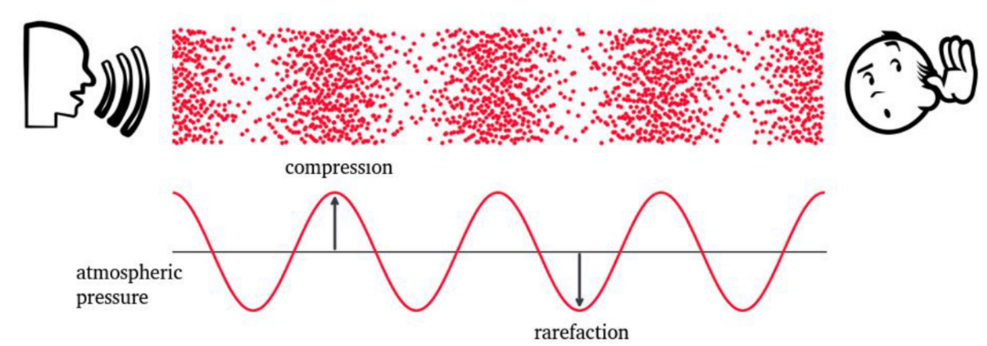
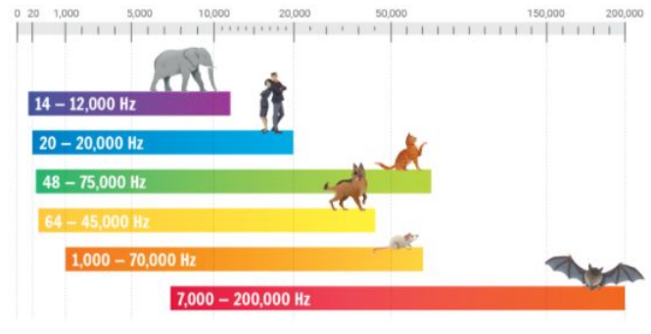
Audio Production
Sound
Produced by vibration of an object
Vibrations cause air molecules to oscillate
Change in air pressure creates a wave
Mechanical wave
Oscillation that travels through space
Energy travels from one point to another
The medium is deformed
Sound is the perception generated by the propagation of mechanical waves caused by the vibration of objects in a medium.
Notes:
Sound Production

Slide 5
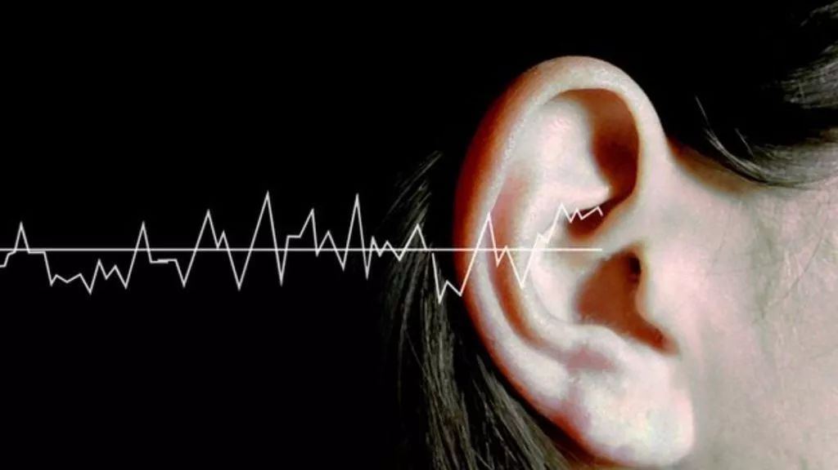

Audio Signal Presentation
Classification of Signals
In signal processing, a signal is a function that conveys information about a phenomenon.
Analog signals are continuous signals whose values change over time.
Digital signals are discrete signals represented by a series of discrete values.
Analog signals
An analog signal is any continuous-time signal representing some other quantity, i.e., analogous to another quantity.
Digital signals
A digital signal is a signal that represents data as a sequence of discrete values.
continuous analog signal
discrete digital signal

Slide 6
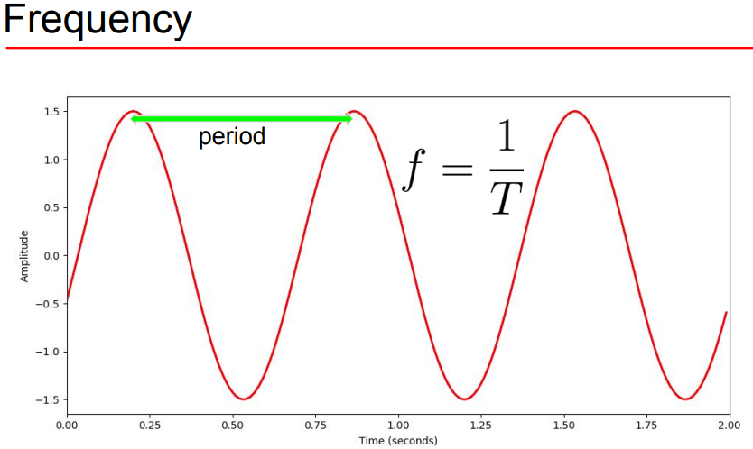
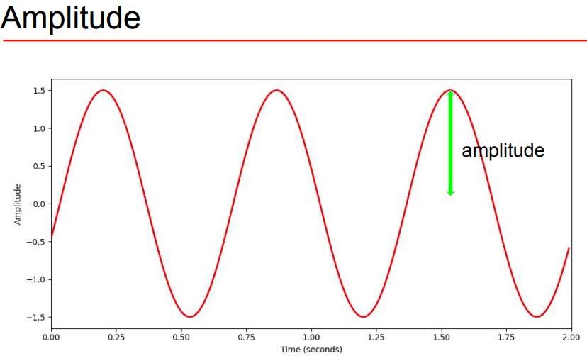
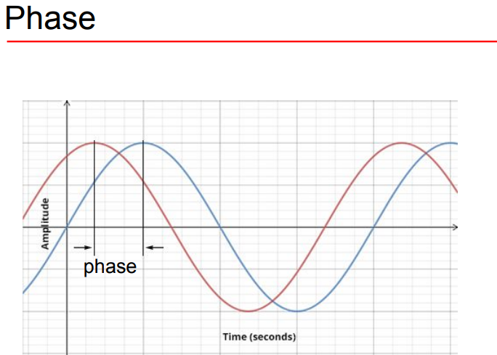
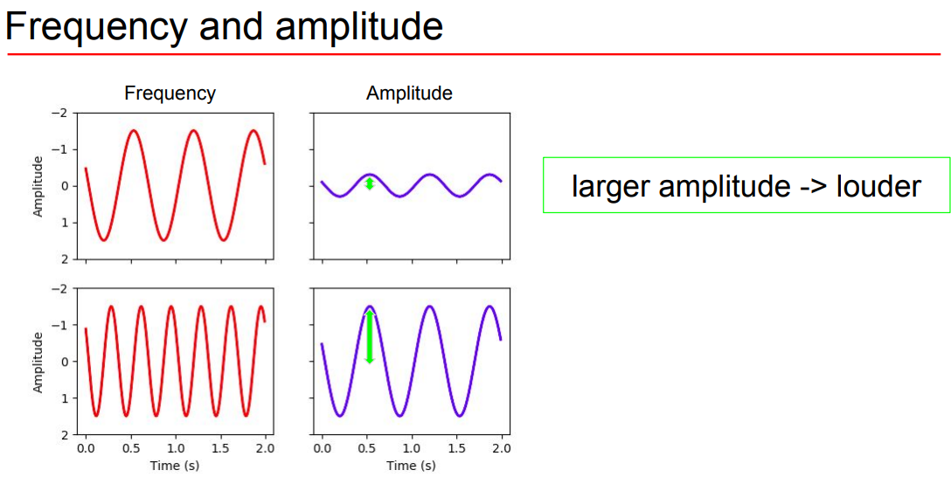
Waveform
Frequency-Amplitude-Phase

Slide 7
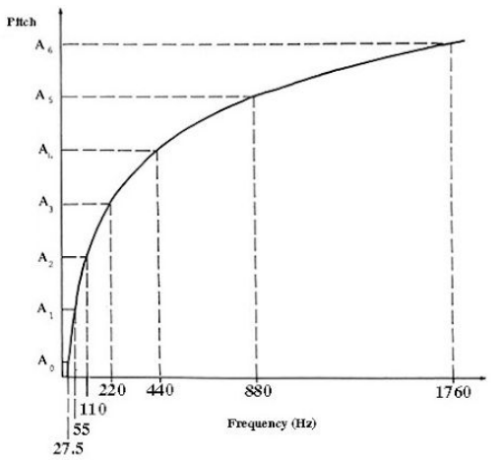
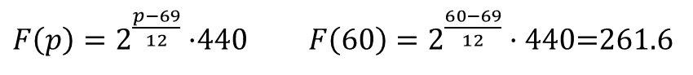
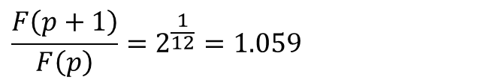
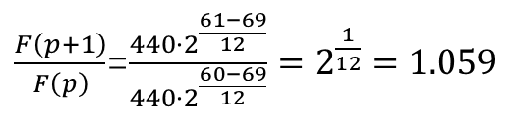
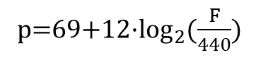
Audio Feature
Pitch（音高）
Pitch is determined by the frequency of sound.
The higher the frequency, the higher the pitch; the lower the frequency, the lower the pitch.
It is typically expressed in units of Hertz (Hz).
Two frequencies are perceived similarly if they differ by a power of 2.
Parameter description
p represents pitch, typically represented using MIDI note numbers.
440(HZ) is the reference frequency, corresponding to the frequency of A4 pitch.
69 is the reference pitch for MIDI note numbers.
12 represents the number of semitones or half steps.
$F\left(p\right)=2^{\frac{p−69}{12}}·$440 $F\left(60\right)=2^{\frac{60−69}{12}}·\text{440}\text{=261.6}$
p=69+12·$\log_{2}{(\frac{F}{440})}$
$\frac{F\left(p+1\right)}{F\left(p\right)}$=$\frac{440·2^{\frac{61−69}{12}}}{440·2^{\frac{60−69}{12}}}=2^{\frac{1}{12}}=1.059$
$$\frac{F\left(p+1\right)}{F\left(p\right)}=2^{\frac{1}{12}}=1.059$$

Slide 8
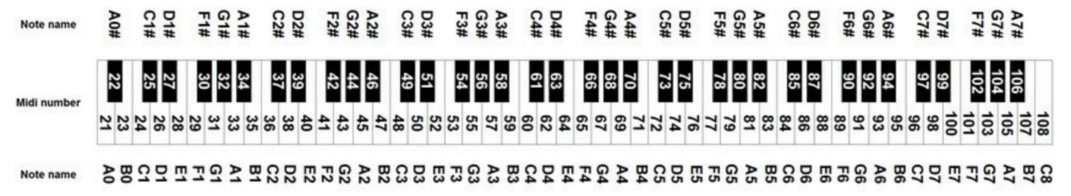
Audio Feature
MIDI（Musical Instrument Digital Interface）
Pitch is typically represented using MIDI note numbers.
Pitches are encoded with 128 different numbers, ranging from 0 to 127.
The octave scale is typically represented using letter names from A to G.
The octave is divided into 12 equally spaced semitones.
Reference：https://www.inspiredacoustics.com/en/MIDI_note_numbers_and_center_frequencies

Slide 9
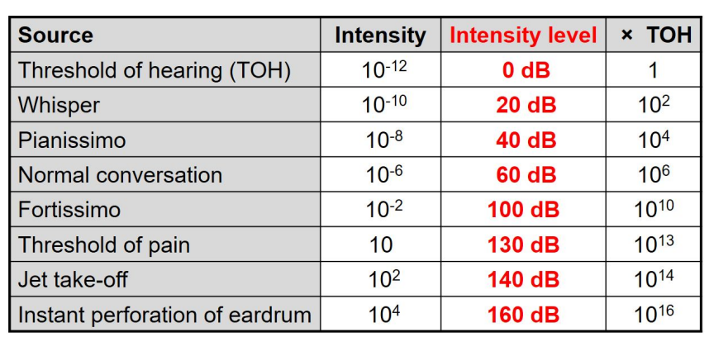
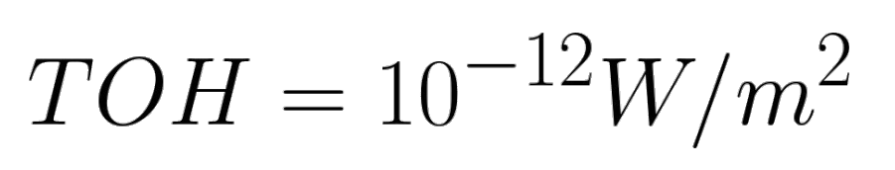
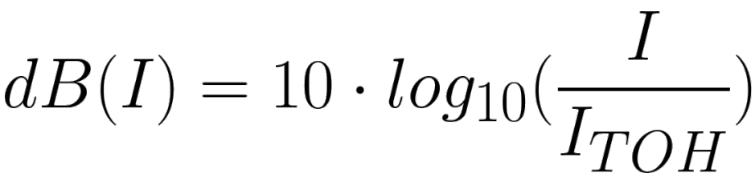
Audio Feature
Sound power（音量）
Rate at which energy is transferred
Energy per unit of time emitted by a sound source in all directions
Measured in watt (W)
Sound intensity
Sound power per unit area
Measured in W/m2
Intensity level
Intensity is a measure of the loudness of sound.
It describes the magnitude (amplitude) of a sound signal, determining its strength and loudness.
It is typically expressed in units of decibels (dB).

Slide 10
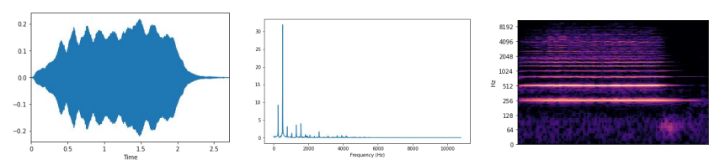
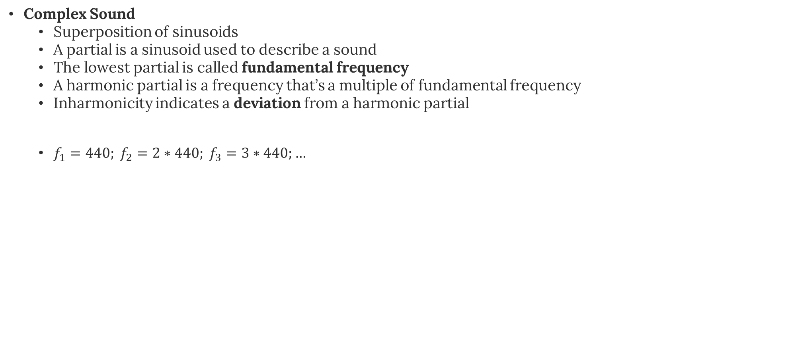
Audio Feature
Complex Sound
Superposition of sinusoids
A partial is a sinusoid used to describe a sound
The lowest partial is called fundamental frequency
A harmonic partial is a frequency that’s a multiple of fundamental frequency
Inharmonicity indicates a deviation from a harmonic partial
$f_{1}=440; f_{2}=2∗440; f_{3}=3∗440;…$

Slide 11
Contents
02.Audio Processing

Slide 12
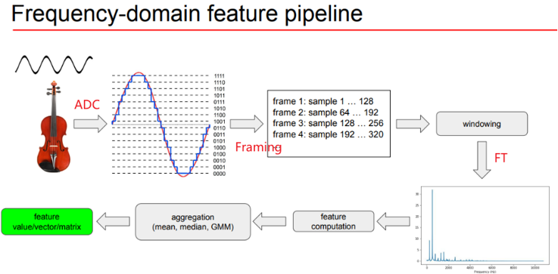
Pipeline
(ADC) Analog to digital conversion
Sampling
Quantization
Framing
Perceivable audio chunk
Spectral Leakage
Windowing
Ham window

Slide 13
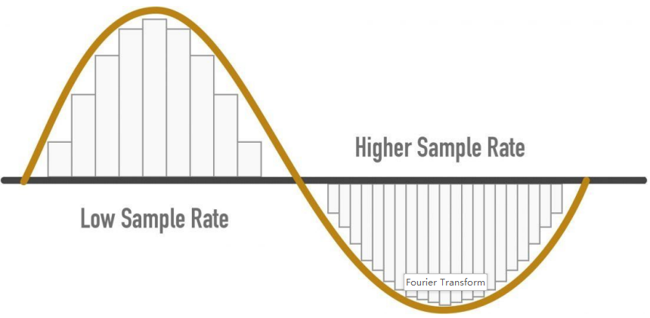
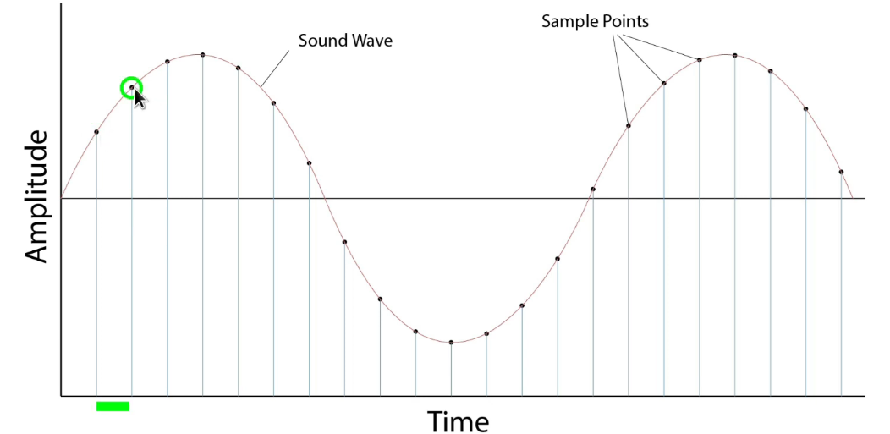
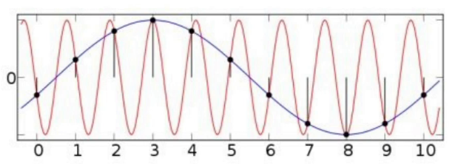
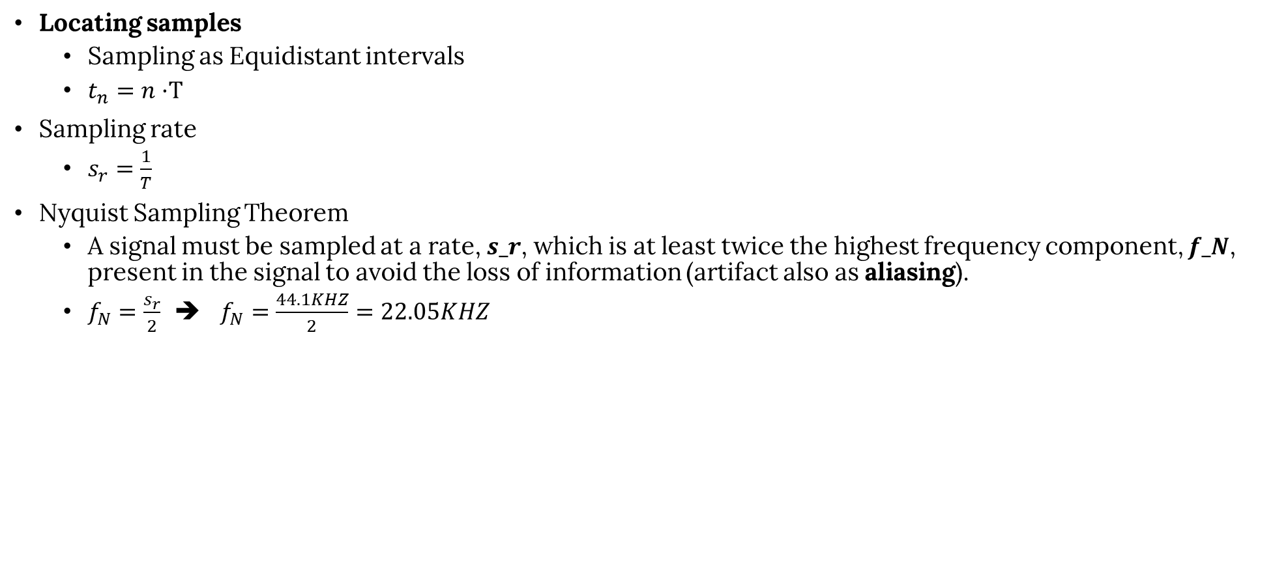
Sampling
Locating samples
Sampling as Equidistant intervals
$t_{n}=n·$T
Sampling rate
$s_{r}=\frac{1}{T}$
Nyquist Sampling Theorem
A signal must be sampled at a rate, 𝒔_𝒓, which is at least twice the highest frequency component, 𝒇_𝑵, present in the signal to avoid the loss of information (artifact also as aliasing).
$f_{N}=\frac{s_{r}}{2}$ ➔ $f_{N}=\frac{44.1KHZ}{2}=22.05KHZ$

Slide 14
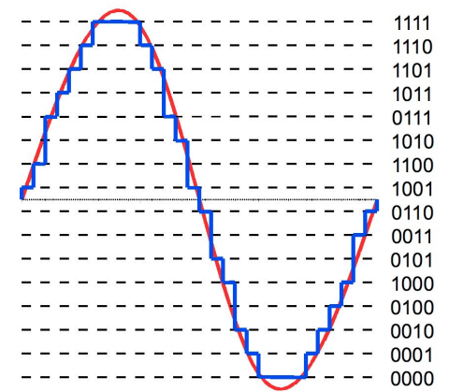
Quantization
Resolution = num. of bits
Bit depth
Number of Bits or Bit Depth Used to Represent Each Sample
Audio with a 16-bit depth allows for 2^16 (65536) different discrete levels for each sample
Signals are typically represented in a discrete form, and each discrete sample can be represented using a certain number of bits.
The amplitude value of each sample represents the amplitude or energy level
of the signal at that particular time point. The entire sequence of
samples forms a complete waveform image.

Slide 15
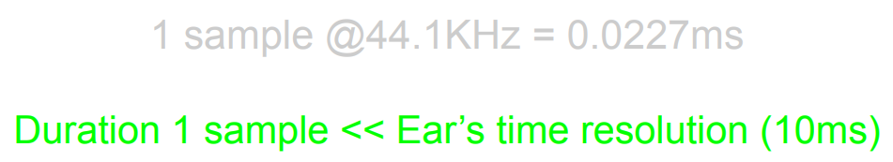
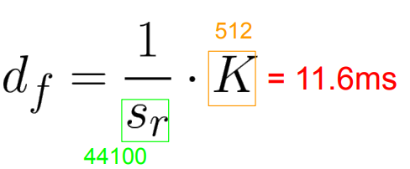
Framing
Perceivable audio chunk
The continuous samples can be processed into perceivable audio chunks by grouping them into units of 10 milliseconds or 20 milliseconds.
This is done to align with the perceptual characteristics of the human ear and provide appropriate time resolution in audio processing and transmission.
Typical range of frame size.
256 – 8192
Power of 2 num. samples

Slide 16
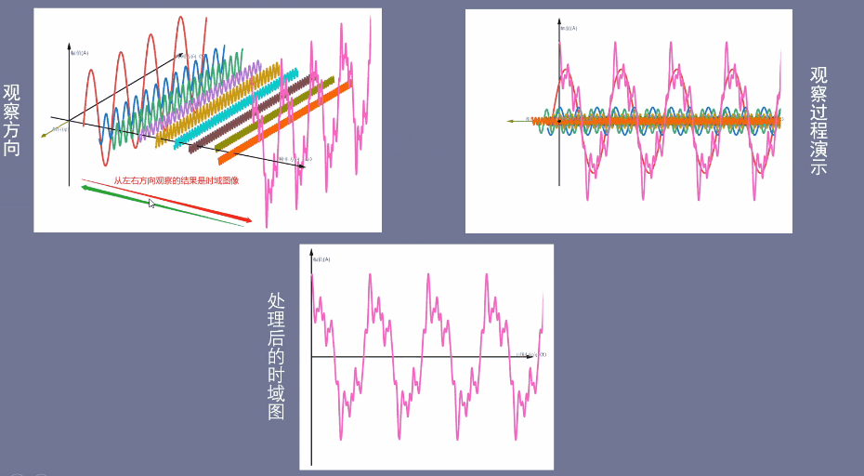
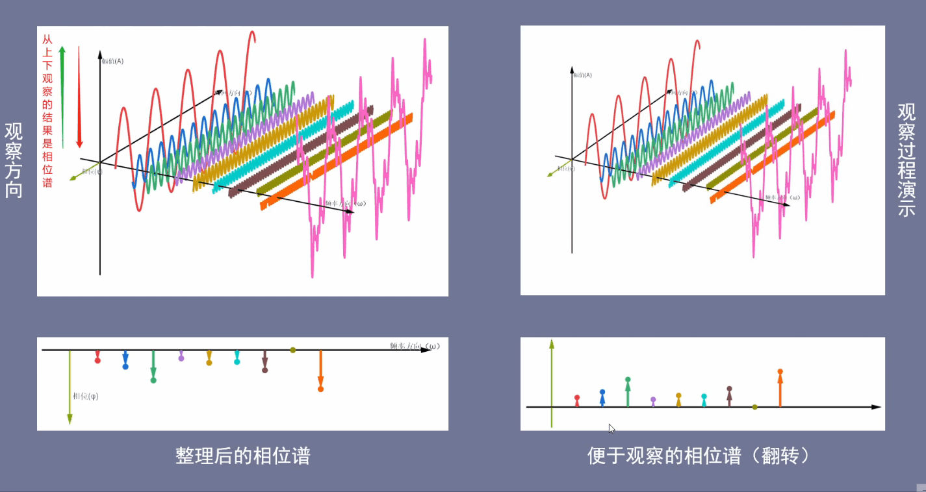
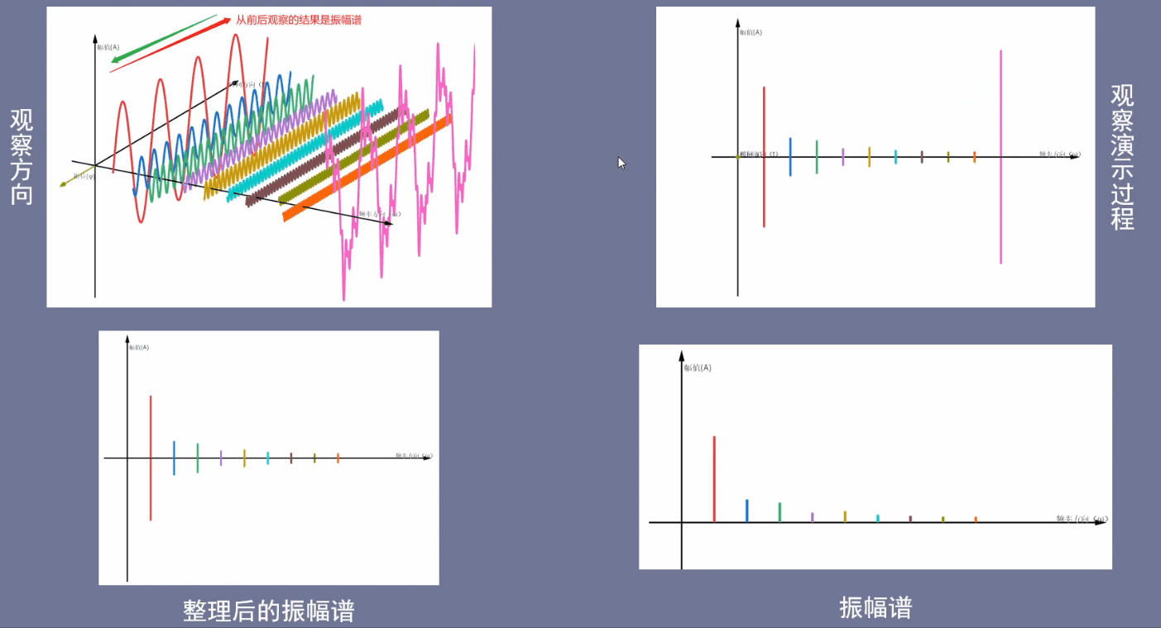
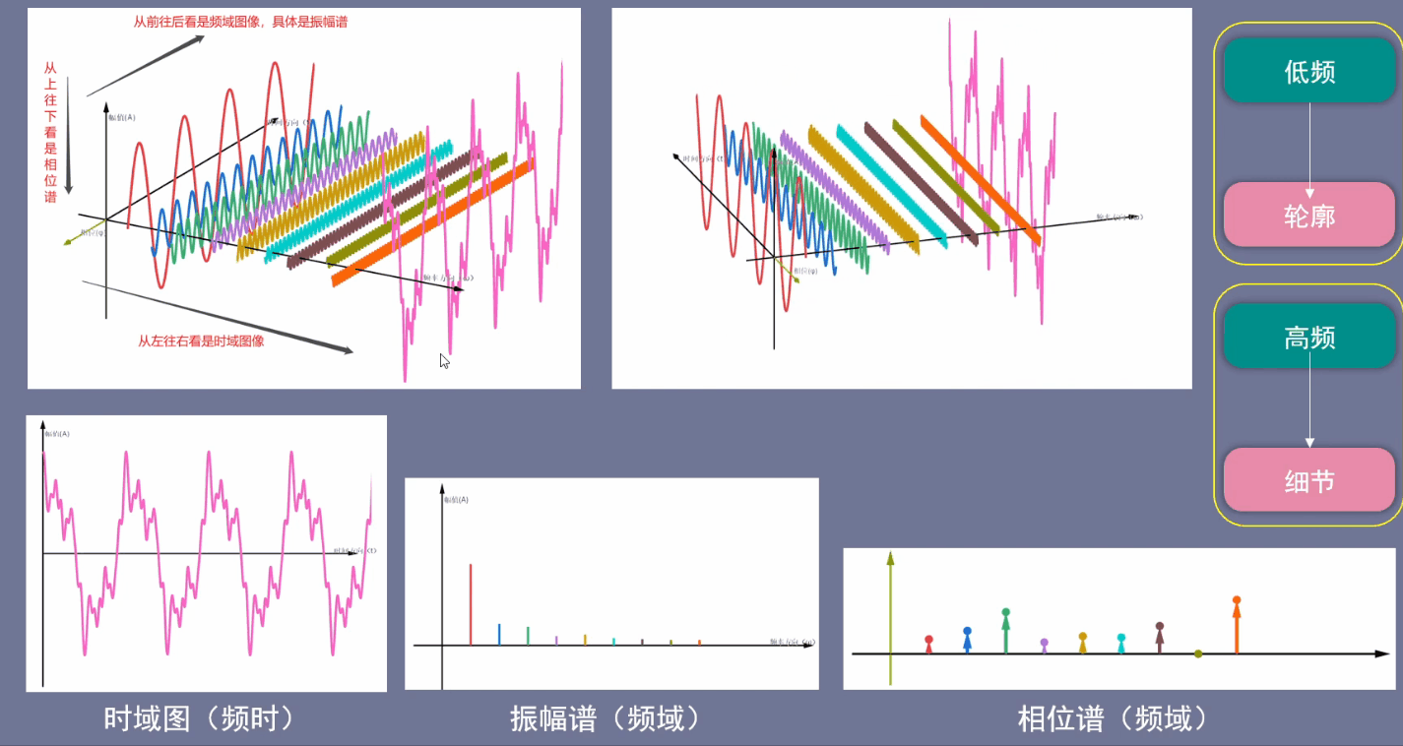
Fourier Transform
Fourier Transform Result
Time-Domain Graph
Frequency-Domain Phase Spectrum
Frequency-Domain Amplitude Spectrum
Overall View

Slide 17
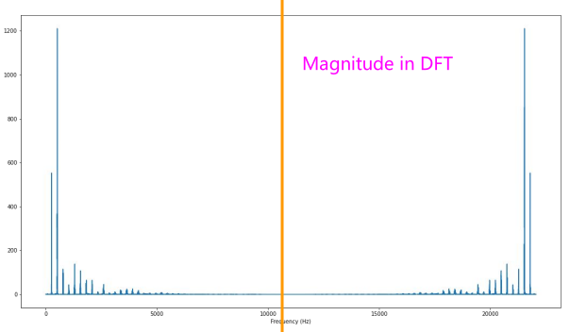
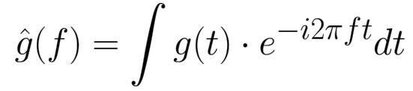
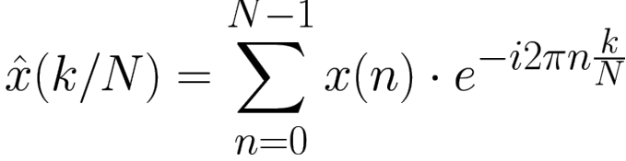
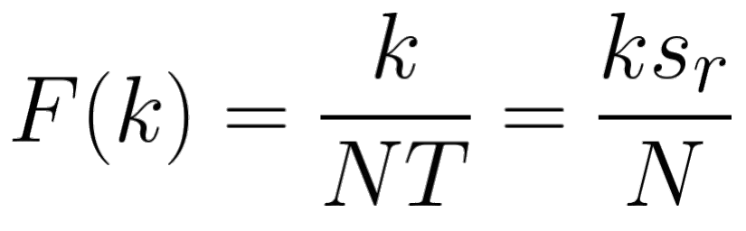
Fourier Transform
What’s it?
Decompose a complex sound into its frequency components.
From time domain to frequency domain
Continuous Fourier Transform
DFT ( Discrete Fourier Transform )
Redundancy in DFT
For an input sequence of length N, the frequency domain representation of the DFT will have N frequency data points, where the first half (from 0 to N/2) contains the valid frequency information.

Slide 18
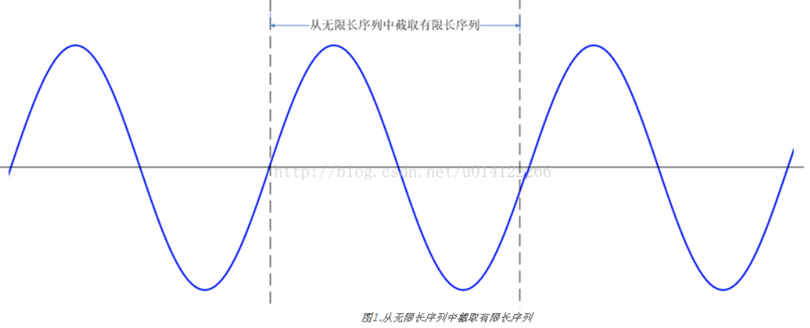
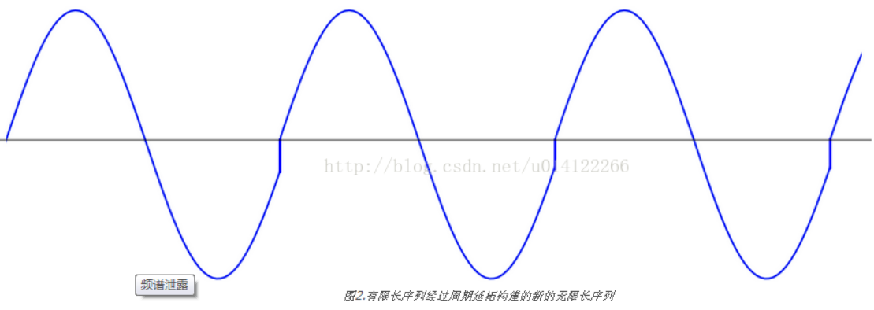
Spectral Leakage
The occurrence of spectral leakage means that the spectral energy of a signal appears as additional distribution in the frequency domain. This results in distortion of the spectrum analysis results and an inability to accurately reflect the frequency components of the original signal.
Periodic Extension
Treating a finite-length sequence as one period of an infinite-length sequence.
Non-Integer Period Truncation
Cause spectral leakage
Add window function

Slide 19
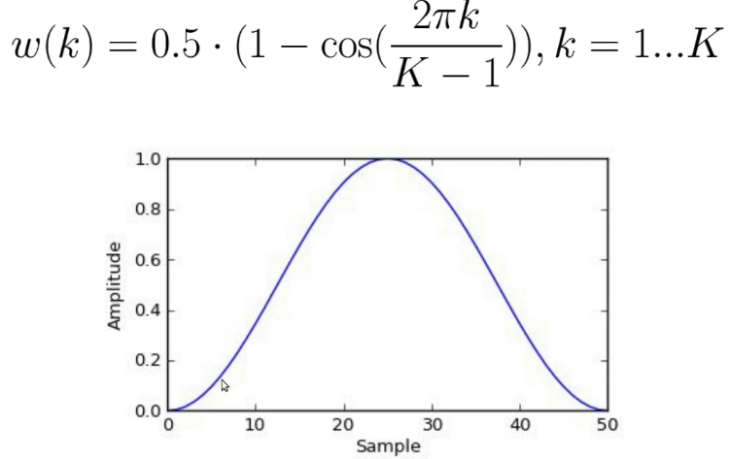
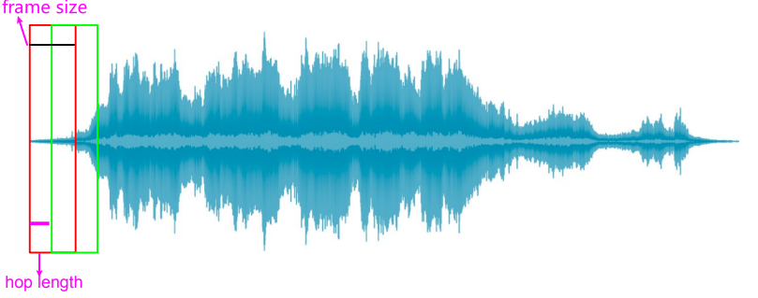
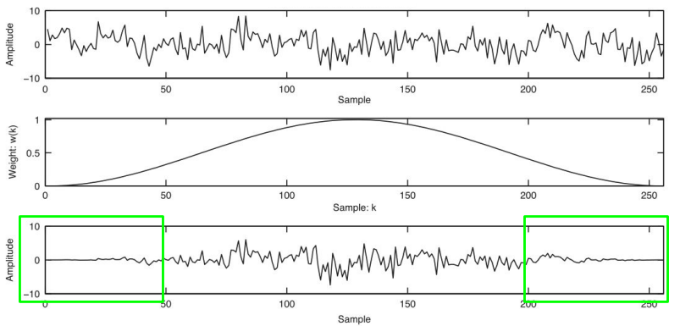
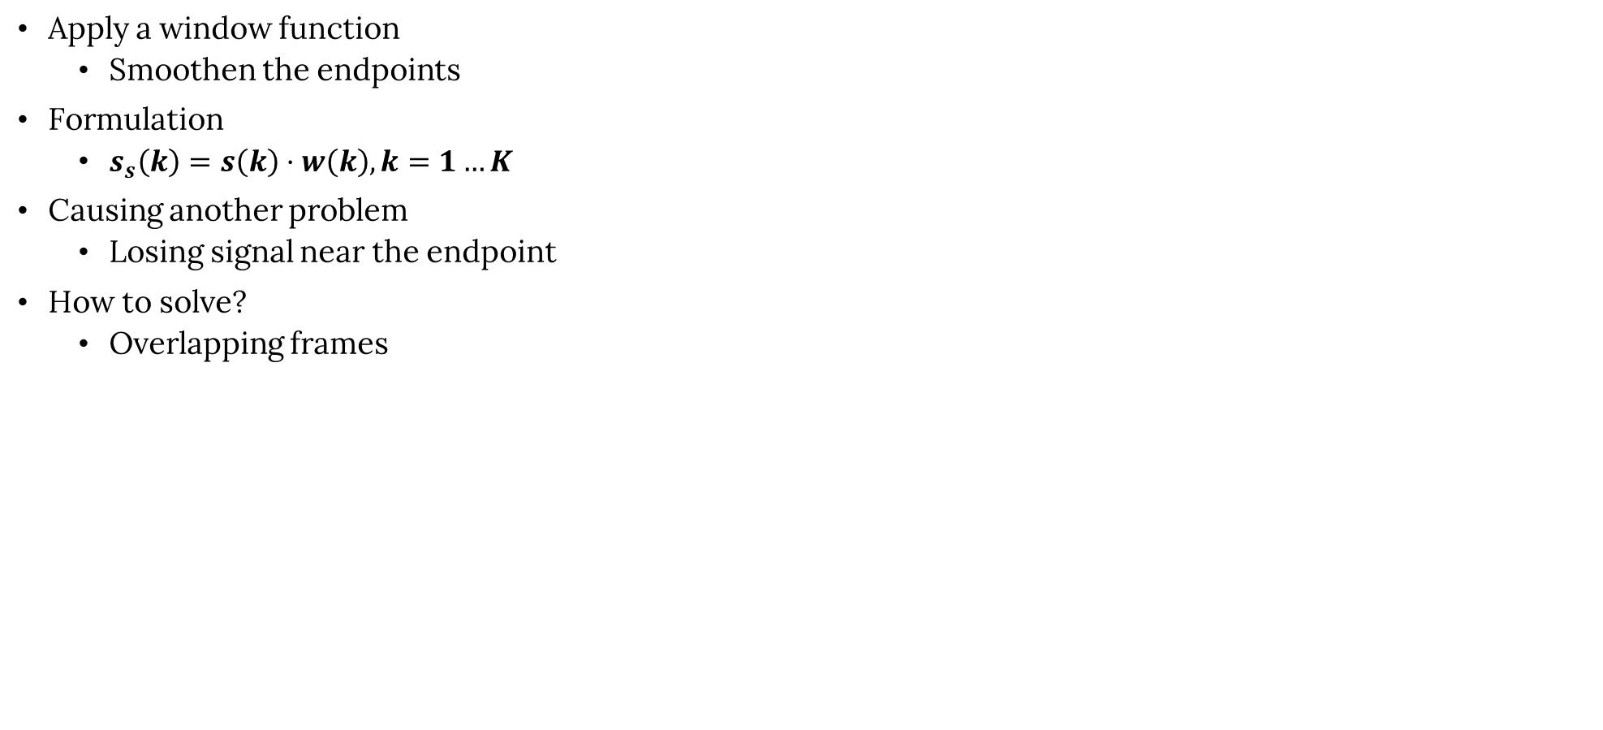
Window
Apply a window function
Smoothen the endpoints
Formulation
$s_{s}\left(k\right)=s\left(k\right)·w\left(k\right), k=1…K$
Causing another problem
Losing signal near the endpoint
How to solve?
Overlapping frames

Slide 20
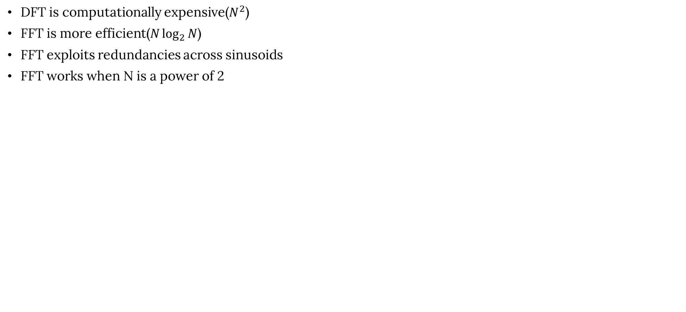
Fast Fourier Transform
DFT is computationally expensive($N^{2}$)
FFT is more efficient($N\log_{2}{N}$)
FFT exploits redundancies across sinusoids
FFT works when N is a power of 2

Slide 21
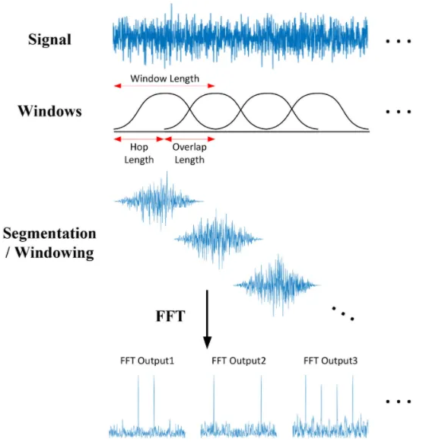
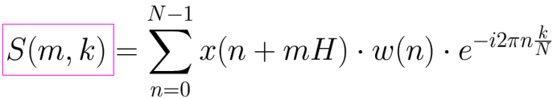
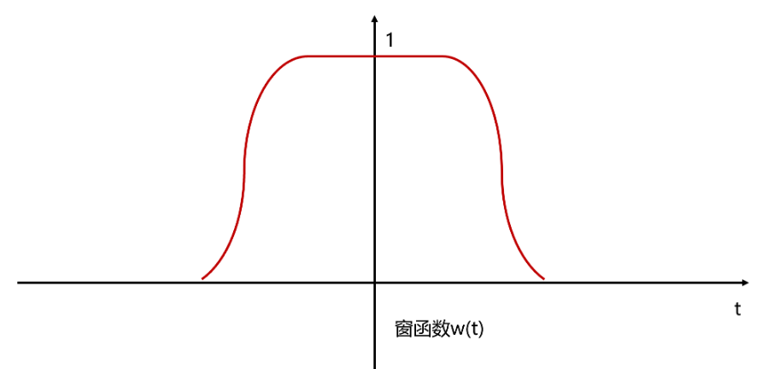
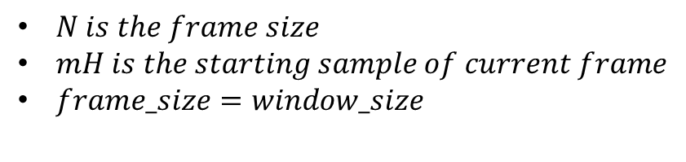
Short Time Fourier Transform
Why use it?
DFT only averages the presence of the frequency components.
Audio signal is dynamic.
The Fourier transform only reflects the characteristics of a signal
in the frequency domain and cannot analyze the signal in the time
domain. In order to relate the time domain and the frequency domain,
the short-time Fourier transform is used.
$N is the frame size$
$mH is the starting sample of current frame$
$frame_size=window_size$
if the statistical properties of a signal such as mean, variance,
power spectrum, etc, remain constant over a short period of time,
it is considered a stationary signal.
The short-time Fourier transform yields the Fourier transform of the
function x(τ) at time τ.

Slide 22
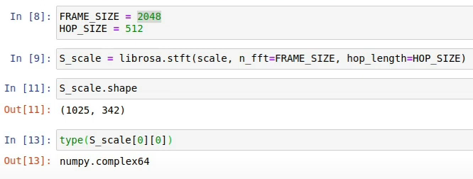
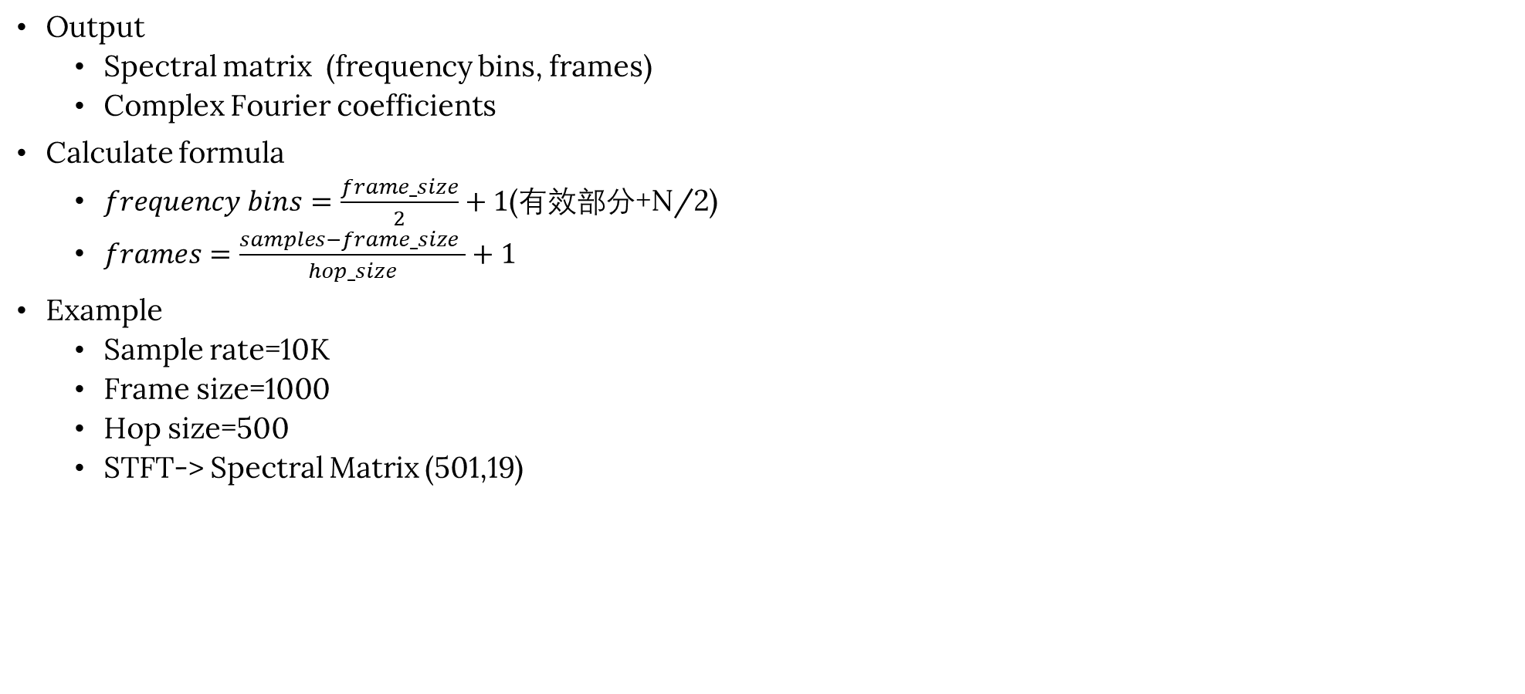
Short Time Fourier Transform
Output
Spectral matrix (frequency bins, frames)
Complex Fourier coefficients
Calculate formula
$frequency bins=\frac{frame_size}{2}+1$(有效部分+N/2)
$frames=\frac{samples−frame_size }{hop_size}+1$
Example
Sample rate=10K
Frame size=1000
Hop size=500
STFT-> Spectral Matrix (501,19)

Slide 23
Contents
03. Mel-Spectrogram

Slide 24
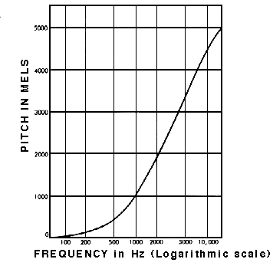
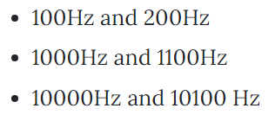
Logarithmically Perception
Humans perceive frequency logarithmically
Are you able to tell each pair of sounds apart?
Human perception of sound is not linear; it is more sensitive to frequency changes in the low-frequency range and less sensitive to frequency changes in the high-frequency range.
Mel frequency uses a non-linear transformation which aligns with the human auditory system’s perception of the pitch of sounds.

Slide 25
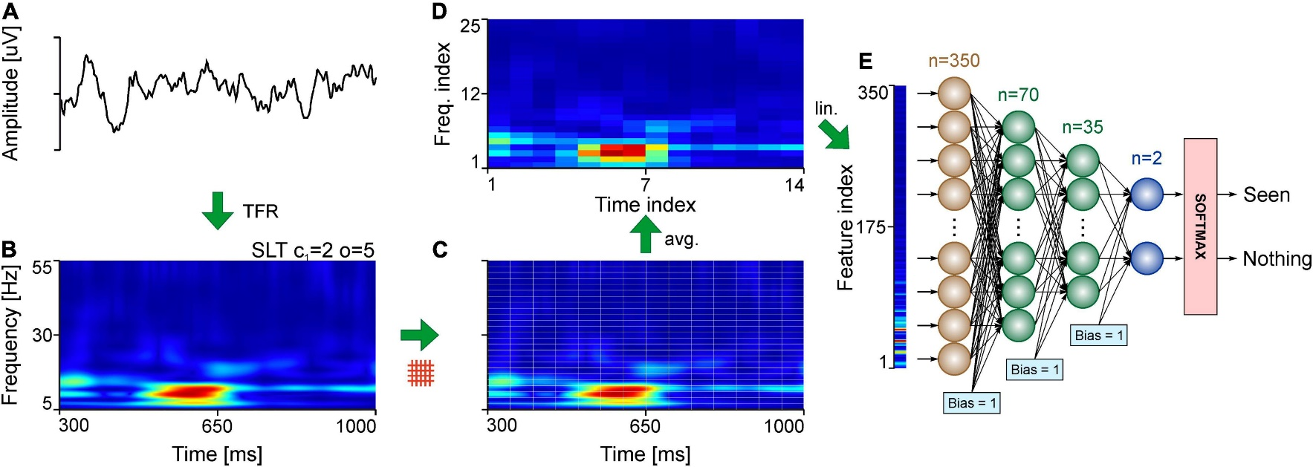
Ideal audio feature
Time-frequency representation
Perceptually-relevant amplitude representation
Perceptually-relevant frequency representation ->Mel spectrograms

Slide 26


Mel-Scale
Mel-Scale
Logarithmic scale
Equal distances on the scale have same “perceptual” distance
500hz~600hz is certainly not the perceptual same as 1000hz~1100hz
500mel~600mel is perceptual same as 1000mel~1100mel
The Mel scale is the most reasonable frequency scale that is uniformly divided based on subjective pitch.
$$m=2595·log{(1+\frac{f}{700})}$$
$$f=700·({10}^{\frac{m}{2595}}−1)$$

Slide 27
Frequency bins
What’s Frequency bins
frequency bins are intervals between samples in frequency domain.
For example, if your sample rate is 100 Hz and your FFT size is 100, then you have 100 points between [0 100) Hz.
Therefore, you divide the entire 100 Hz range into 100 intervals, like 0-1 Hz, 1-2 Hz, and so on. Each such small interval, say 0-1 Hz, is a frequency bin.

Slide 28

Mel Bands
What’s Mel Filter Banks
Mel bands is a frequency division method based on the perception of pitch by the human auditory system.
Mel bands can better simulate the perceptual sensitivity of the human ear to different frequency ranges.
How to do?
It divides the frequency range into a series of perceptually uniform intervals.
Same as Hyperparameters
Same to leaning rate
Ranging from 20~128
Merge adjacent Mel bands.
Ignore the remaining frequency bands.
Each discrete frequency bin represents a range of frequencies, and it is typically represented by its center frequency.

Slide 29



Mel Filter Banks
What’s Mel Filter Banks
triangular filter
The mechanism of Mel filter banks is mainly designed to simulate the auditory mechanism of human ears. The cochlea, which is essentially the functioning part of the ear, acts as a bank of filters. The filtering action of the cochlea occurs on a logarithmic frequency scale.
Mel filter bank’s shape
$M=\left(bands, \frac{frame_size}{2}+1\right)$
STFT
$Y=(\frac{frame_size}{2}+1,frames)$
$\frac{frame_size}{2}+1$ is the frequency bins
Calculate the Mel Spectrogram
Use matrix multiplication
$Mel=M·Y$
$Mel shape=$ $(bands,frames)$

Slide 30


Extract Mel spectrogram
Process
Extract STFT
Convert amplitude to DBs
Convert frequencies to Mel scale
Choose number of Mel bands
How many Mel bands?
It depends on the problem
Construct Mel filter banks
Convert lowest/highest frequency to Mel
Create bands equally spaced points
Convert points back to Hertz
Round points to nearest frequency bin
Ensure that each center frequency value of the Mel band corresponds to a specific frequency bin.
Create triangular filters
Apply Mel filter banks to spectrogram
分段线性

Slide 31
Contents
04.Conclude

Slide 32

MFCC

Slide 33

MFCC

